Slide 1

A Short History of Belgian
Gastronomy
Peter Scholliers

Slide 2

80 years of gastronomy
Content of talk:
1910: state of affairs
Development of own identity
Supporters & preservers of Belgian cuisine
Belgium’s renown in 2000

Slide 3
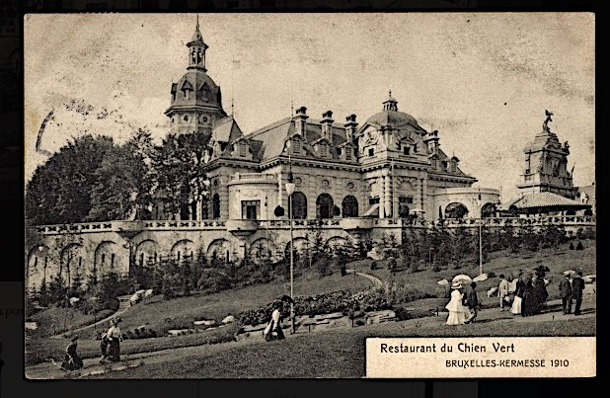
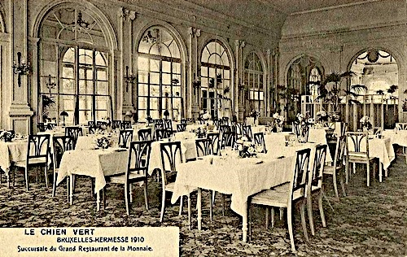
1. Brussels 1910 world exhibition: state of affairs
Le Chien Vert, 1910 World Exhibition, Brussels, opened by
Grand Restaurant de la Monnaie, http://www.retroscoop.com/amusement.php?artikel=286,
https://belgique-insolite-et-occulte.blogspot.be/2016/10/bruxelles-1910-exposition-universelle.html

Slide 4
80 years of gastronomy
(Grand) Restaurant de la Monnaie
Rue Léopold, 7 – 9 (opened after construction of new post office on Monnaie square), expanded to no. 13.
-1885-1914, owner Charles Smedt
-tax class: from 9b (1884) to 4b (1888), sign of fast progress
-reflects the impressive growth of culinary Belgium in the Belle Epoque

Slide 5
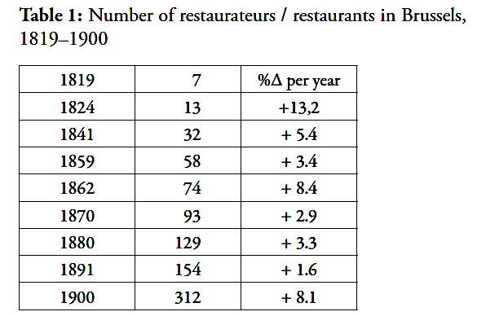
Reasons for expanding number of restaurants:
➔ Demand by patrons
International position of Belgium (port of Antwerp, financial centre Brussels,…)
Economic thriving ( 1913: 2nd richest nation of the world, GDP per head)
Supply by catering trade
3) Entrepreneurs open small and(very) big restaurants
4) Intensive international exchange of cooks and waiters, especially with France

Slide 6
80 years of gastronomy
Reputation of Brussels / Belgium
c. 1880: perfect copy of French haute cuisine (names of places and dishes, ordering of dishes; décor; menu cards; wines; service,…)
E.g., “Ces restaurants sont élégants, dans le genre des restaurants de Paris à la carte; tout y est bon, mais naturellement cher” (K. Baedeker, Manuel du voyageur, 1878, p.12)

Slide 7
80 years of gastronomy
Reputation of Brussels / Belgium
c.1910: local elements were introduced and highly appreciated
E.g., “(Les Bruxellois) tiennent en Europe la première place comme gastronomes émérites et épicuriens distingués; ils ont le palais fin et le goût friand et relevé (...). Bruxelles offre à la curiosité du touriste des promenades gastronomiques qu’on ne saurait faire en aucune autre ville de ce monde (...). On y trouve la bonne cuisine bourgeoise, le waterzooi de poulet, les oiseaux sans tête, le lapin aux pruneaux, la carbonnade flamande, les moules marinières d’Anvers” (Octave Uzanne, Le Figaro Illustré, June 1910, p. 6)

Slide 8
80 years of gastronomy
2. Development of own identity
-French gastronomy renovated
#Auguste Escoffier’s nouvelle cuisine (c. 1900, with worldwide breakthrough in 1920s),
#stress on regional cuisine, ‘natural’ & local taste
-Tourism developed swiftly
#(rail)road, automobiles, hotel accommodation, guides, …
-Consequences of World War I
#visitors of Belgian battle fields (global sympathy for the violated country; huge inflation → low cost)

Slide 9
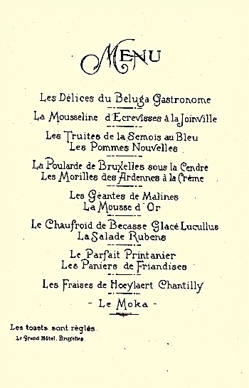
Example of a “national” menu, Le Grand Hôtel, Brussels, April 1926, with references to
“Bruxelles”, “Semois”,
“Ardennes”, “Malines”,
“Rubens”, Hoeylaert”

Slide 10
80 years of gastronomy
E.g. (source: Guide Gourmand, 1937-38, published by Club).
“Hôtel Cosmopolite, Place Rogier, Restaurant très soigné. Nombreuses spécialités de cuisine belge. Prix très raisonnables. Recommendé” (p. 26)
“Hôtel Barcelone, Andenne, Cuisine régionale bourgeoise faite par le patron, ancien congolais” (p. 11)
“Hôtel des Etrangers, Spa, Cuisine bourgeoise et régionale. Bonne cave, avec 5 p.c. de remise à nos membres. Recommandé” (p. 74)
Also, lots of mentioning of “spécialités locales”: (anguilles, plats mosans, du pays, d’Ardennes, de la côte,…)

Slide 11
80 years of gastronomy
3. Supporters & preservers of Belgian cuisine
Diners
Chefs
Journalists
→ the “golden trio”
Associations
Club des Gastronomes: mix of the “golden trio”

Slide 12
80 years of gastronomy
3. Supporters & preservers of Belgian cuisine
Diners
Chefs
Journalists
Associations
e.g., Club des Gastronomes

Slide 13
80 years of gastronomy
Club des gastronomes (31.12.1938)
Based on Le Club de la Bonne Auberge (Brussels, 1933)
Inspired by Maurice Sailland (Curnonsky, the “prince of gastronomes”)

Slide 14
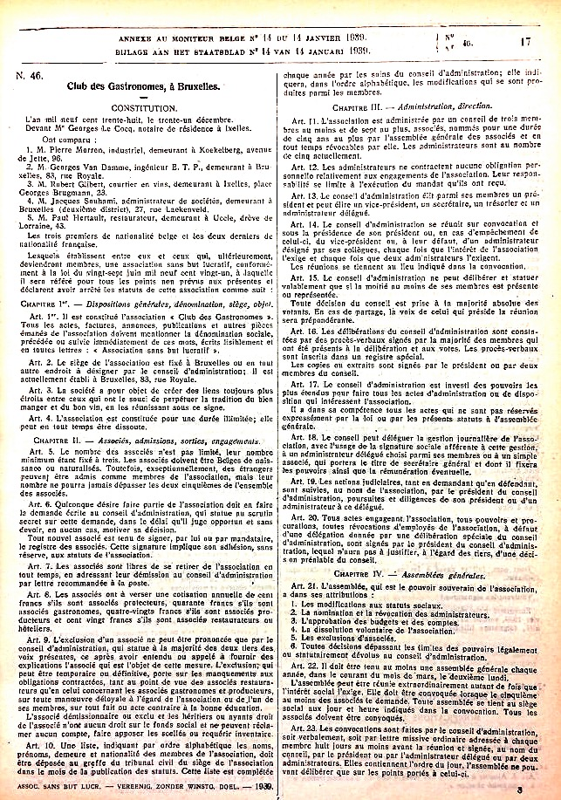
a.s.b.l. Club des Gastronomes
31.12.1938
Pierre Morren, industriel (B), président
Georges Van Damme, ingénieur (B)
Robert Gilbert, courtrier en vins (B)
Jacques Souhami, administrateur (F), vice-président
Paul Herrault, restaurateur (F)

Slide 15
80 years of gastronomy
Art. 3 (aim):
“La société a pour objet de créer des liens toujours plus étroits entre ceux qui ont le souci de perpétuer la tradition du bien manger en du bon vin, en les réunissant sous ce signe”
Art. 5 to 10 (membership):
-members to be accepted after written demand
-membership fee:
120 frs (c. 600 €) associés restaurateurs / hôteliers
100 frs (c. 500 €) associés protecteurs
80 frs (c. 400 €) associés producteurs
40 frs (c. 200 €) associés gastronomes
[average monthly gross wage of civil servant: c. 1,000 frs)

Slide 16
80 years of gastronomy
Activities:
Publication of
La Bonne Table (1939-1940),
L’Echanson des gourmets (1946-[1962]
Annual discerning of prizes (since 1954)
Dining ! If food and eating are a means of communication, which messages were sent ?
→ consider menus in the 1950s and 1990s:

Slide 17
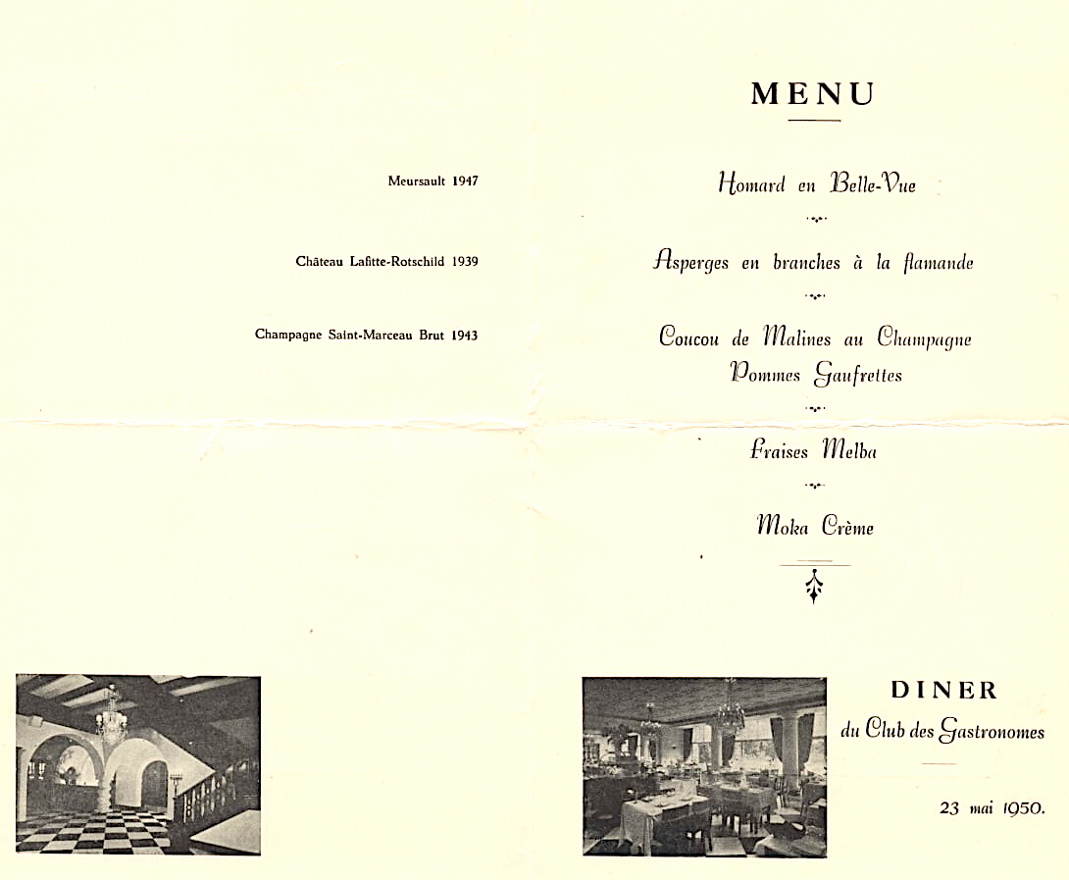


Slide 18
80 years of gastronomy
More local references:
Choesels au Madère, fromage des Trappistes de Chimay (Le Mail, 1952); Truite de la Lesse (Aéroport, 1953); Waterzoie de homard (Le Carlton, 1954); Asperges de Malines, Coupe floralie gantoise (Aéroport, 1955); etc etc…
... But far less references to ‘Belgianness’ in the 1990s (Coucou de Malines; Crevettes grises de Zeebrugge / Ostende; Leffe)
What happened ?

Slide 19
80 years of gastronomy
More local references:
Choesels au Madère, fromage des Trappistes de Chimay (Le Mail, 1952); Truite de la Lesse (Aéroport, 1953); Waterzoie de homard (Le Carlton, 1954); Asperges de Malines, Coupe floralie gantoise (Aéroport, 1955); etc etc…
... But far less references to ‘Belgianness’ in the 1990s (Coucou de Malines; Crevettes grises de Zeebrugge / Ostende; Leffe)
What happened ?

Slide 20
80 years of gastronomy
-total break-through of new Nouvelle Cuisine (P. Bocuse etc.; Gault & Millau), late 1960s
-quality norm becomes French
-foreign (i.e., Asian) cuisines are explored and inserted
-local (European) cuisines and specialties loose significance
-globalization of haute cuisine
-role of Club des Gastronomes?

Slide 21
80 years of gastronomy
Aim: “…perpétuer la tradition du bien manger…” :
which tradition?
concern is not about Belgian cuisine…
Dinners reflected general trends in gastronomy
Dinners were not innovative or daring

Slide 22
80 years of gastronomy
4. State of Belgian gastronomy in 2000
Best pupil in (French) class
Not only imitation, but addition to nouvelle cuisine
Internationally recognized (“Europe’s best kept secret”)
Yet, loss of attention to local foodways

Slide 23
Bibliography
J. Csergo, “Le club des Cent, 1912-1930”, in: Gastronomie et identité culturelle française, F. Hache-Bissette & D. Saillard (eds): Nouveau Monde, 2009, pp.177-201.
M. Jacobs, “Endives, Brussels sprouts and other innovations”, in: Culinary Cultures of Europe. Identity, Diversity and Dialogue. Goldstein, D. & Merkle, K. (eds.): Council of Europe Publishing, 2005, pp. 75-85.
P. Scholliers & A. Geyzen, “Upgrading the local. Belgian cuisine in global waves”, Gastronomica, 10: 2 (2010), pp. 49-54.
P. Scholliers, “The diffusion of the restaurant culture in Europe in the 19th century: the Brussels connection”, Food & History, 7: 2 (2009), pp. 45-68.
P. Scholliers, Food culture in Belgium, Greenwood Press, 2009.
Anon., “Belgian Cuisine”, https://en.wikipedia.org/wiki/Belgian_cuisine

